Slide 1
Irritant GAses
Gillian Beauchamp, MD
Notes:
Irritant gases – chlorine, ammonia, phosgene, phosphine

Slide 2
Phosgene
Ammonia
Phosphine
Chlorine

Slide 3
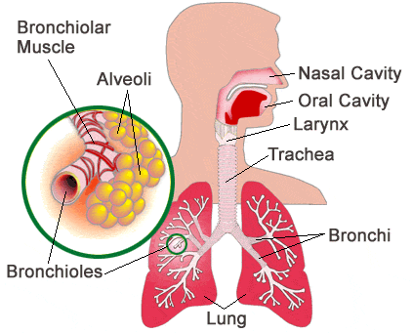
Irritant Gases: general effects
Classified according to water solubility: determines clinical effects
  Highly water-soluble
    mucous membranes of eyes & upper airway
  Intermediately water-soluble
    upper airway & alveoli
  Slightly water-soluble
    alveolar-capillary membrane
    Inadequate warning properties
      Can result in prolonged exposures
    delayed-onset acute lung injury (ALI)
www.medicinenet.com

Slide 4
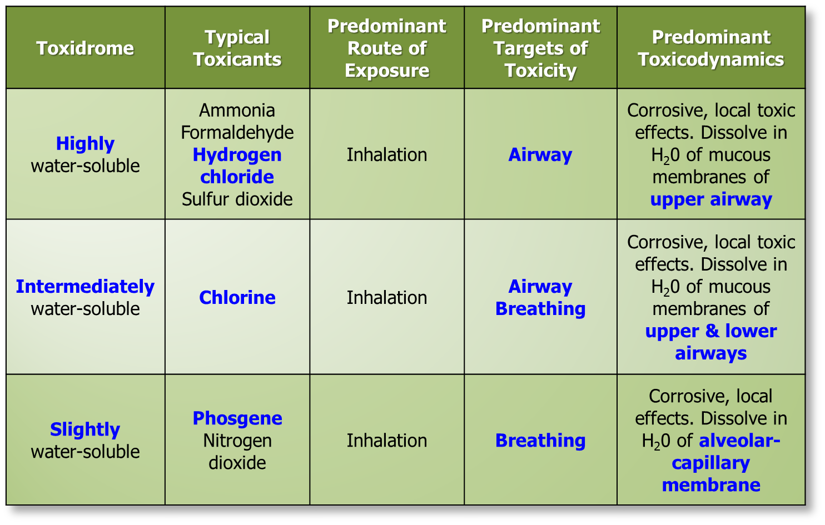

Slide 5
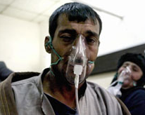
Irritant Gas Chemoterrorism
Chlorine gas (Cl₂) chemical weapons in Iraq
  Jan. 28, 2007
    Truck bomb with Cl₂ tank
      deaths > 12
  Feb. 20, 2007
    Bomb on Cl₂ tanker truck
      > 150 poisoned
        > 60 hospitalized
  Feb. 21, 2007
    Truck bomb with Cl₂ cylinders
      deaths > 5
      > 55 hospitalized
www.edition.cnn.com

Slide 6
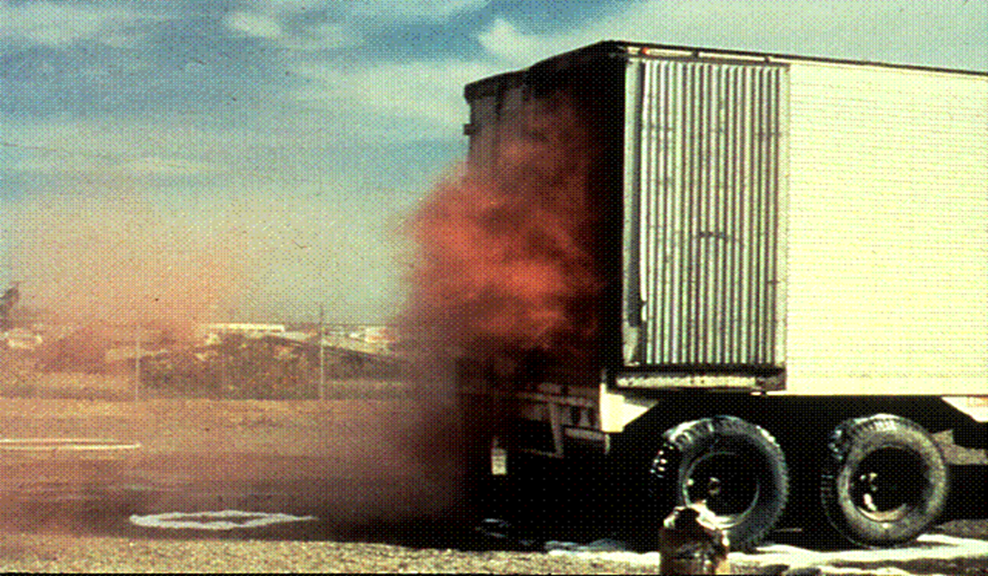
Nitrogen Dioxide
Truck with nitrocellulose x-ray film
Slightly water-soluble irritant gas
Red-brown color
Delayed-onset ALI
Photo credit: Mike Vance, MD
Notes:
This occurred when a truck warehousing old nitrocellulose film x-rays burned producing nitrogen dioxide, the classic red-brown gas. You may encounter nitrogen dioxide in etching when nitric acid reacts with zinc to form NO2.

Slide 7
Irritant Gases: Respiratory signs & symptoms
Highly water-soluble
  Burning sensation
  mucus production
  Upper airway edema
  Dysphonia
  Stridor
  Laryngospasm
  Aphonia
Highly, intermediately, & slightly water soluble
  Tachypnea
  Late bradypnea
  Delayed respiratory arrest
Slightly water-soluble
  Wheezing & bronchospasm
  Rales
  ALI
Notes:
Review definitions:
Aphonia: inability to speak; dysphonia: hoarsness
Signs and symptoms depend on dose and duration of exposure. Highly water soluble gases produce upper airway signs. Aphonia is a very bad sign suggesting imminent airway obstruction. Slightly water soluble gases produce lower airway signs. Chlorine gas is intermediately soluble.

Slide 8
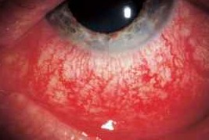
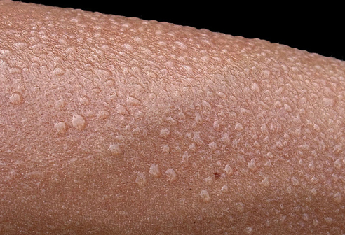
Irritant gases: skin and mucous membranes
Highly water-soluble irritant gases
  Rhinorrhea
  Lacrimation
  Conjunctival injection
  Burning eye pain
Sympathetic effects
  Cool
  Pale
  diaphoretic
Cyanosis
www.alpfmedical.info
reference.Medscape.com
Notes:
Note that highly water soluble gases produce upper airway symptoms. Cyanosis is seen with greater than 5 g/dL of deoxyhemoglobin.

Slide 9
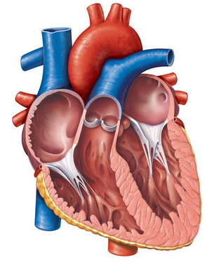
Irritant Gas: cardiovascular effects
Cause: hypoxemia
  Tachycardia
  Tachydysrhythmias
  Myocardial ischemia
    chest pain
    Myocardial infarction
    Cardiac arrest
Notes:
Hypoxemia is essentially a “resting stress test”. Low oxygen stimulates chemoreceptors in the carotid body and aortic arch leading to tachycardia.

Slide 10
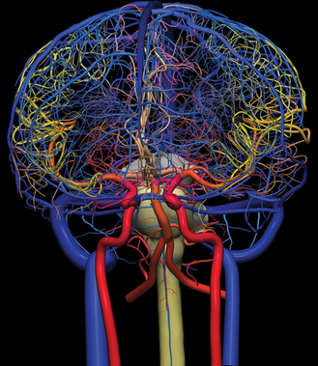
Irritant gases: Neurological effects
Cause: CNS hypoxia
  Anxiety
  Agitation
  Confusion
  Seizures
  Ams & coma
  Death

Slide 11
Irritant gas: GI symptoms
Highly water-soluble
  Corrosive, local toxic effect on oropharyngeal mucous membranes
  Burning pain
    Mucosal inflammation
    Edema of mouth & throat
Any noxious toxicant can cause
  Nausea
  Vomiting

Slide 12
Quiz
Which irritant gases predominantly affect the upper airway?
  Highly water-soluble
  Intermediately water-soluble
  Slightly water-soluble
  Insoluble
Notes:
Highly water soluble

Slide 13
Quiz
Which irritant gases predominantly affect the upper airway?
  Highly water-soluble
  Intermediately water-soluble
  Slightly water-soluble
  Insoluble
Notes:
Highly water soluble

Slide 14
Quiz
Which irritant gases predominantly affect the alveoli?
  Highly water-soluble
  Intermediately water-soluble
  Slightly water-soluble
  Insoluble
Notes:
Slightly water soluble

Slide 15
Quiz
Which irritant gases predominantly affect the alveoli?
  Highly water-soluble
  Intermediately water-soluble
  Slightly water-soluble
  Insoluble
Notes:
Slightly water soluble

Slide 16
Irritant gas: management - Decontamination
Remove patient from source
Respiratory
  Ensure adequate ventilation & oxygenation
Skin
  May not need skin decon, if gas exposure only
    If in doubt: decon
  Diaphoretic skin can require decon
Notes:
Ventilation is the priority in irritant gas exposures

Slide 17
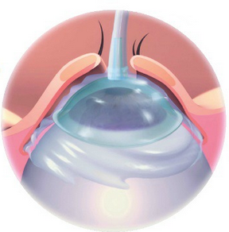
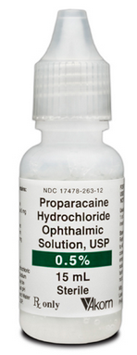
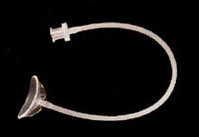
Decontamination: eye
    Water, lactated Ringers, or normal saline
    Eye irrigation lenses
    Topical anesthetic
    Endpoint for irrigation: conjunctival pH of 7 and improved symptoms
Notes:
Decon eyes if symptomatic

Slide 18

Notes:
Eye decon important even in gas exposures, look for tearing and injection. Emphasize that pH paper must read both sides of 7, sometimes the reported toxin may be incorrect. If pH paper is basic or acidic only and reads 7, you don’t know if it’s really 7.

Slide 19
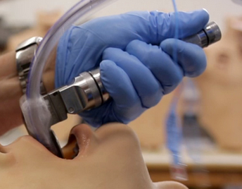
Irritant gas: Acute resuscitation - airway
  High risk with highly & intermediately water-soluble irritant gases
  Suction
  Early endotracheal intubation
    Oropharyngeal burns or edema
    Dysphonia
    Stridor
    Aphonia

Slide 20
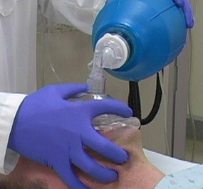
Irritant gas: Acute resuscitation - Breathing
  If Adequate spontaneous ventilation: 15 L/min oxygen
  Inadequate spontaneous ventilation
    Bag-valve-mask ventilation with 100% O₂
    Endotracheal intubation
  Bronchospasm: beta-agonist via nebulizer

Slide 21
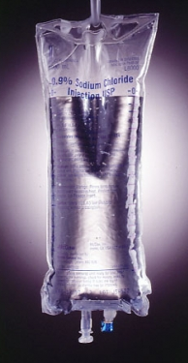
Irritant gas: Acute resuscitation - Cardiovascular
  Cardiac monitor
    monitor for dysrhythmias
  IV or IO isotonic crystalloid for shock
    Monitor for pulmonary edema
Notes:
Primary targets of irritant gases will be A and B.

Slide 22
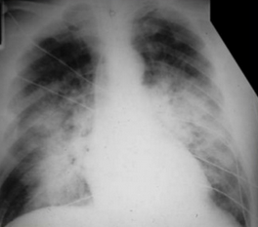
Irritant gas: disposition
  Significant exposure to slightly water-soluble irritant gases
    Phosgene
    Nitrogen dioxide
  Admit for 24 h monitoring
    Even if mild initial symptoms
    Delayed ALI
Notes:
Basics - intubate early before airway swells shut. Some patients need to go for observation due to delayed onset. Phosgene and nitrogen dioxide are “toxic time bombs” - patients can have prolonged asymptomatic exposure, delayed presentation, and ARDS.

Slide 23
Quiz
Which is most important for victims with irritant gas inhalations?
  Cricothyroidotomy
  Oxygen
  Tracheostomy
  Ventilation
Notes:
Ventilation

Slide 24
Quiz
Which is most important for victims with irritant gas inhalations?
  Cricothyroidotomy
  Oxygen
  Tracheostomy
  Ventilation
Notes:
Ventilation

Slide 25
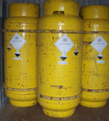
Mystery case 1
29 M petroleum refinery worker
spill of ‘neutralizing agent’
Describes a ‘suffocating’ smell
Reports eye, nose, & mouth irritation
Cough
No shortness of breath
Notes:
Ammonia: highly water soluble – affects airway – corrosive effects

Slide 26
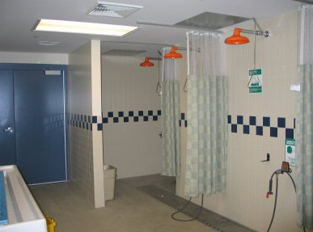
Decontamination?
Likely gas exposure
Unknown agent
  decon with copious water
  prior to entering patient care area
emergencymedicalassociates.com
Notes:
Example of an ED decontamination area

Slide 27
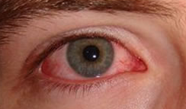
exam
Protecting airway
Cough
Clear breath sounds
No stridor or dysphonia
Conjunctival injection
Rhinitis
Pharyngitis

Slide 28
Quiz: Given exam findings, what is the water solubility of this agent?

Slide 29
Quiz: Given exam findings, what is the water solubility of this agent?
Highly water soluble irritant gas

Slide 30
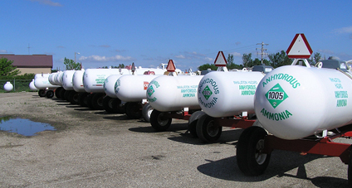
Anhydrous ammonia
Highly water soluble irritant gas
Sources of exposure
  Fertilizer manufacture
  Commercial refrigerant
  Explosive manufacture
  Solvent in textile manufacture
  Ore extraction/purification in mining
  Neutralizing agent in petroleum manufacture
www.dli.mn.gov

Slide 31
Ammonia: Toxicity
Colorless, flammable gas at room temperature
Shipped as liquid (under its own vapor pressure)
  Burns, freezing, corrosion of tissues
Forms ammonium hydroxide in solution
  strong base: liquefactive necrosis
  Dissolves in water covering mucous membranes
  Corrosive solution: mucous membrane irritation & inflammation

Slide 32
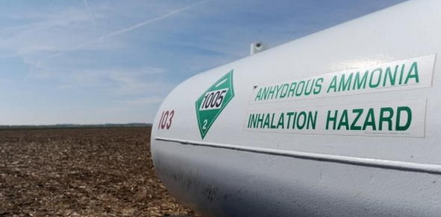
Ammonia: safety & regulation
OSHA STEL: 35 ppm TWA
  (15 minutes over 8 hour day)
NIOSH REL: 25 ppm TWA
  (8 hour time weighted average)
ACGIH TLV: 25 ppm
  per 8 hour work day X 40 hour work week
http://www.cdc.gov/niosh
Notes:
Limits are designed to protect against irritant effects: air samples are corrected and tested via chromatography
OSHA (occupational safety and health admin) STEL: short term exposure limit
NIOSH (national institute for occupational safety and health) REL: recommended exposure limit
ACGIH (American conference of governmental industrial hygenists) TLV: threshold limit value

Slide 33

Prevention
Decon: water
Prevention: soap and water
No eating or smoking prior to preventive decon
Dilutional ventilation of work area

Slide 34
Disposition
Observation of patient until symptoms improve
Mostly upper airway and mucosal tissues affected

Slide 35
Mystery case 2
56 year old male train engineer
Train derailment at low speed due to track damage
EMS personnel report driving through a ‘yellow cloud’
EMS and Fire personnel reversed course, donned full SCBA
Patient complains of difficulty breathing
Hazardous materials personnel report they are investigating the contents of a 90 ton hazardous chemical tank being transported by the train
Notes:
Cases: ammonia, chlorine, phosgene/phosphine

Slide 36

Decon
Likely Gas – but if in doubt….DECON with water
Vapor exposures require skin decontamination
Remove clothing
Head to toe
Red zone: SCBA
Hospital: gown, gloves, mask

Slide 37
Exam
Patient coughing but speaking in 2-3 word sentences
Diffuse wheezing bilaterally
Patient states he felt like he was being ‘suffocated’
Describes a pungent and irritating smell ‘like bleach’
Complains of throat pain

Slide 38
Quiz: Given exam findings, what is the water solubility of this agent?

Slide 39
Quiz: Given exam findings, what is the water solubility of this agent?
Intermediately water-soluble irritant gas

Slide 40
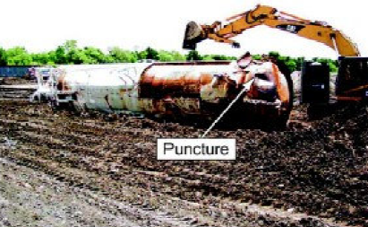
Chlorine gas
Yellow-green gas
Typically shipped as a liquid under its own vapor pressure
  With puncture: released as plume of gas
Pungent, suffocating and irritating
Forms hydrochloric acid in contact with moisture
Notes:
Image from Macdona, TX 2004 – derailment of train carrying 90 ton chlorine tank

Slide 41
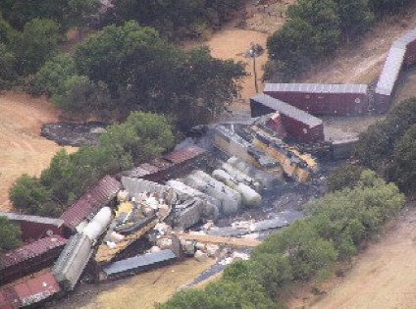
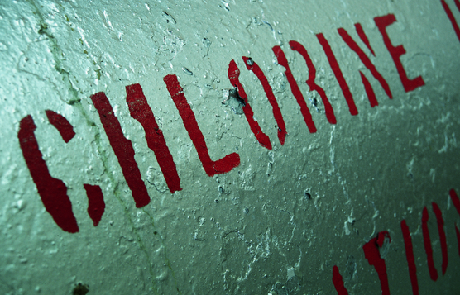
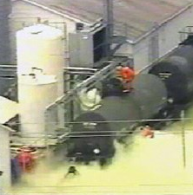

Slide 42
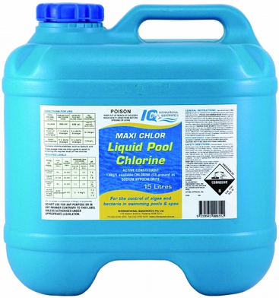
Chlorine: Who is at risk?
Used in:
  Water purification
  Swimming pool disinfectant
  Bleaching
  Plastic and rubber production
  Polyvinyl chloride (PVC) production
  Military poison gas

Slide 43
Injury pattern
Predominantly inhalational injury
Chemical and freezing injury with contact with liquid: corneal necrosis, ‘frostbite’
Eye, nose, throat irritation: conjunctivitis & lacrimation
Cough
Death due to respiratory failure
Acute: lung injury resolves in 7-14 days
Chronic: bronchitis, reactive airway disease pattern

Slide 44

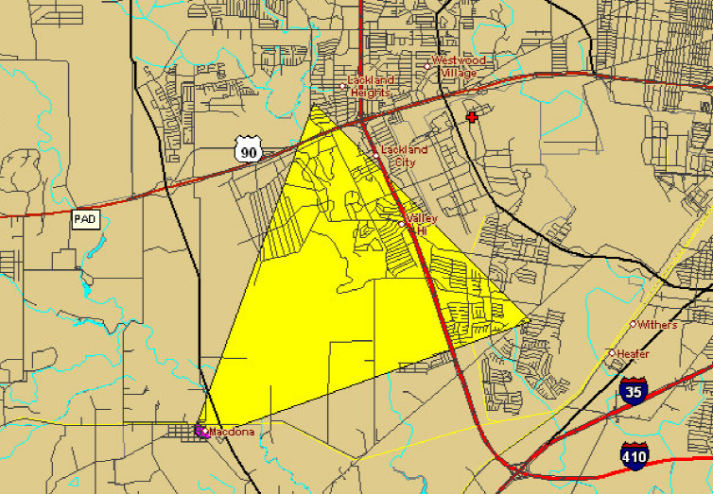
Chlorine gas: Safety & regulation
NIOSH IDLH: 10 ppm
ACGIH TWA: 0.5 ppm (Over 8 hours)
ACGIH STEL: 1 ppm (Over 15 minutes)
OSHA PEL: 1 ppm
Example: Large exposure: 20 ppm – recommended initial evacuation distance of 800 feet, Protective action distance ~5 Miles
http://www.cdc.gov/niosh/ershdb/
Notes:
A PEL is usually given as a time-weighted average (TWA), although some are short-term exposure limits (STEL) or ceiling limits. A TWA is the average exposure over a specified period of time, usually a nominal eight hours. A short-term exposure limit (STEL) is the acceptable average exposure over a short period of time, usually 15 minutes as long as the time-weighted average is not exceeded. STEL is a term used in occupational health, industrial hygiene and toxicology.

Slide 45
Disposition
Upper and lower airway affected
Watch for delayed lung injury: 24 hours
Watched for airway injury
Nebulized bronchodilators, oxygen

Slide 46
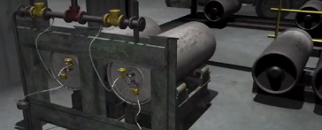
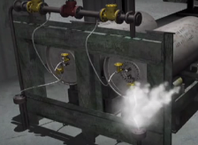
Mystery case 3
38 year old female worker at chemical manufacturing plant
Compressed gas tanks used to manufacture pesticide ingredients
1 ton cylinders stored in a shed
Gas accessed via flexible braided stainless steel hoses
Worker was inspecting the cylinders when a hose burst
Notes:
Dupont factory, WV in 2010 – lethal phosgene exposure

Slide 47
Patient history
Patient states she was coughing initially
Feels well in the ED
Smell of ‘moldy hay’
Noted a colorless vapor leaking from the hose
The patient would like to be discharged back to work to finish her inspection

Slide 48
DEcon
Field Decon: water if skin exposure
Move patient away from exposure
Hospital: standard PPE
Water spray may be used by hazmat team to knock down vapor

Slide 49
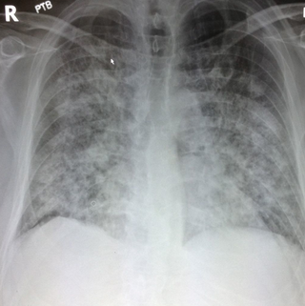
Disposition
4 hours into ED observation: significant difficulty breathing
Admission: at 18 hours post-exposure, patient requires intubation in the ICU
ALI

Slide 50
Quiz: Given exam findings, what is the water solubility of this agent?

Slide 51
Quiz: Given exam findings, what is the water solubility of this agent?
Slightly water-soluble irritant gas

Slide 52
Pathophysiology: phosgene exposure
Slightly water soluble gases: phosgene and nitrogen dioxide – mild irritation of upper airway with no significant warning properties
Phosgene reacts with water in alveoli: produces hydrochloric acid
Corrosive local effect on alveolar-capillary membrane: decreased surfactant production, alveolar collapse and chemical pneumonitis
Onset of acute lung injury can be delayed for hours after exposure

Slide 53
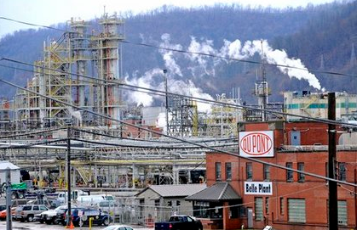
Patients at risk
Polyurethane production
Polycarbonate production
Dye, resin & pesticide production
Metallurgy ore separation
Military poison gas
Notes:
Dupont factory in WV
AKA carbonic dichloride or carbonyl dichloride

Slide 54
Phosgene effects
Acute effects: choking, coughing
X ray: delayed pulmonary edema and lung injury
Chronic: Emphysematous changes + fibrosis

Slide 55
Phosgene: safety & regulation
Odor threshold: 0.4 ppm
Severe Respiratory symptoms: 2-3 ppm
Niosh IDLH: 2 ppm
OSHA PEL/NIOSH REL/ACGIH TLV: 0.1 ppm (0.4 mg/m³)
ACGIH STEL: 0.2 ppm (15 minutes)

Slide 56
Phosphine
Colorless gas
Used in semiconductor industry: introduce phosphorous into silicone crystals
Fumigant
Shipped in liquid form
Inadequate warning properties
Vapors are heavier than air: low lying exposure

Slide 57
Phosphine effects
Lung irritation and cough
Delayed pulmonary edema (72 hours)
Vomiting, diarrhea and liver damage
Death from respiratory failure, liver failure/renal failure and shock
Chronic bronchitis with long-term exposure

Slide 58
Phosphine: safety & regulation
NIOSH STEL: 1 ppm
NIOSH TWA/OSHA PEL: 0.3 ppm (over work day)
NIOSH IDLH: 50 PPM

Slide 59
Final Quiz: match the irritant gas with its water solubility
Chlorine Gas
Anhydrous ammonia
Phosgene & Phosphine
Highly water soluble
Slightly water soluble
Intermediately water soluble

Slide 60
Final Quiz: match the irritant gas with its water solubility
Chlorine Gas
Anhydrous ammonia
Phosgene & Phosphine
Highly water soluble
Slightly water soluble
Intermediately water soluble

Slide 61
Final Quiz: match the irritant gas with its water solubility
Chlorine Gas
Anhydrous ammonia
Phosgene & Phosphine
Highly water soluble
Slightly water soluble
Intermediately water soluble

Slide 62
Final Quiz: match the irritant gas with its water solubility
Chlorine Gas
Anhydrous ammonia
Phosgene & Phosphine
Highly water soluble
Slightly water soluble
Intermediately water soluble

Slide 63
Questions?

